Slide 1
To replace with my own drawing

Slide 2
CSS143 Computer Programming (II)

Slide 3
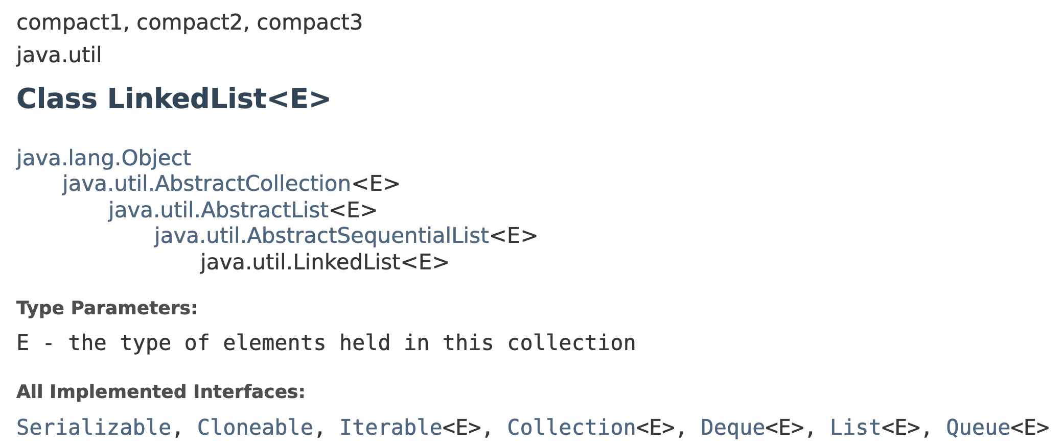
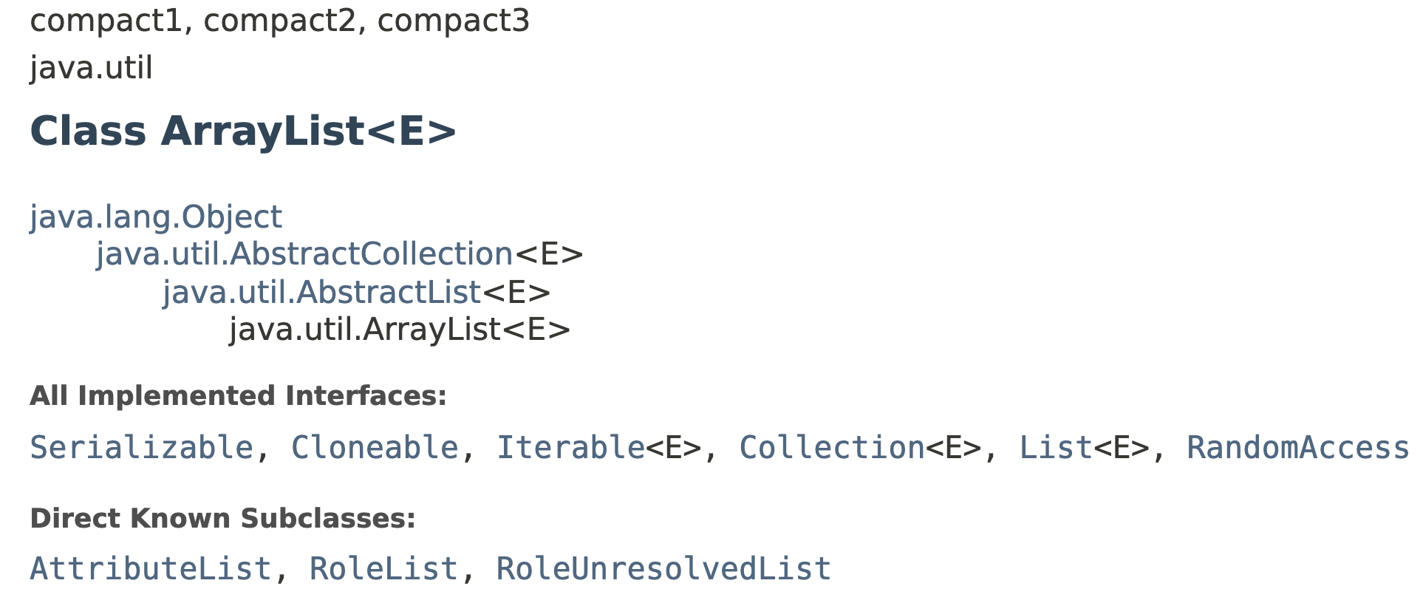
Question
What’s the difference between this two classes?

Slide 4

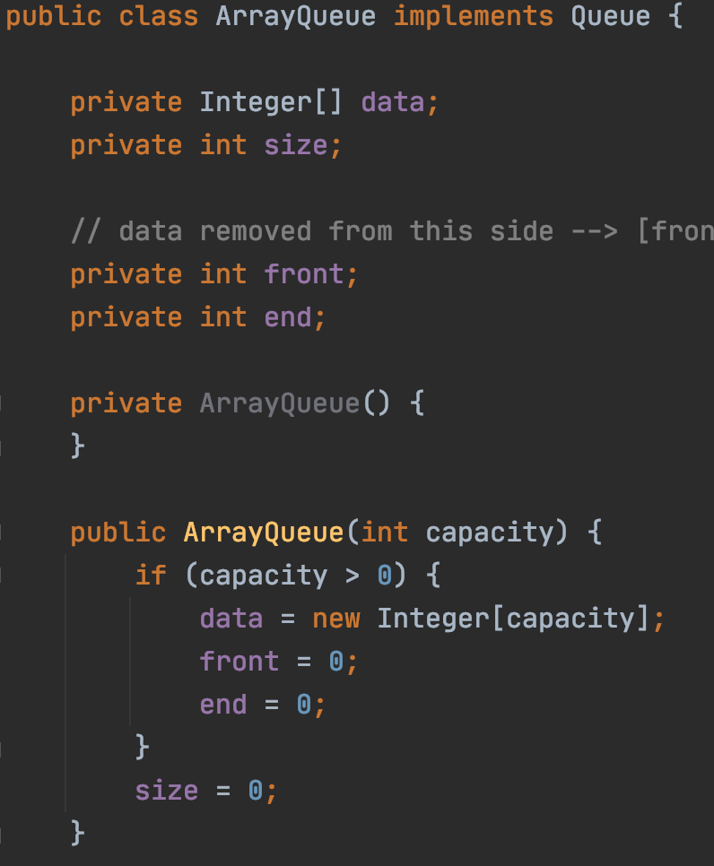
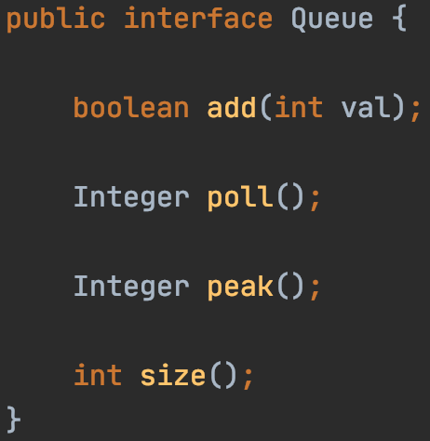
Abstract Data Type (ADT) Queue
Interface
Implementation

Slide 5
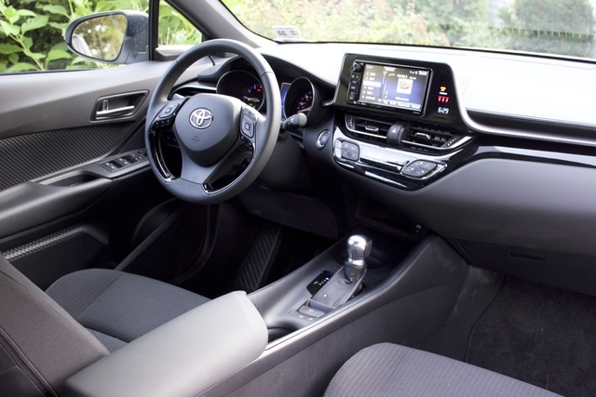


“Interface vs Implementation”

Slide 6


“Interface vs Implementation”

Slide 7

ADT Queue

Slide 8
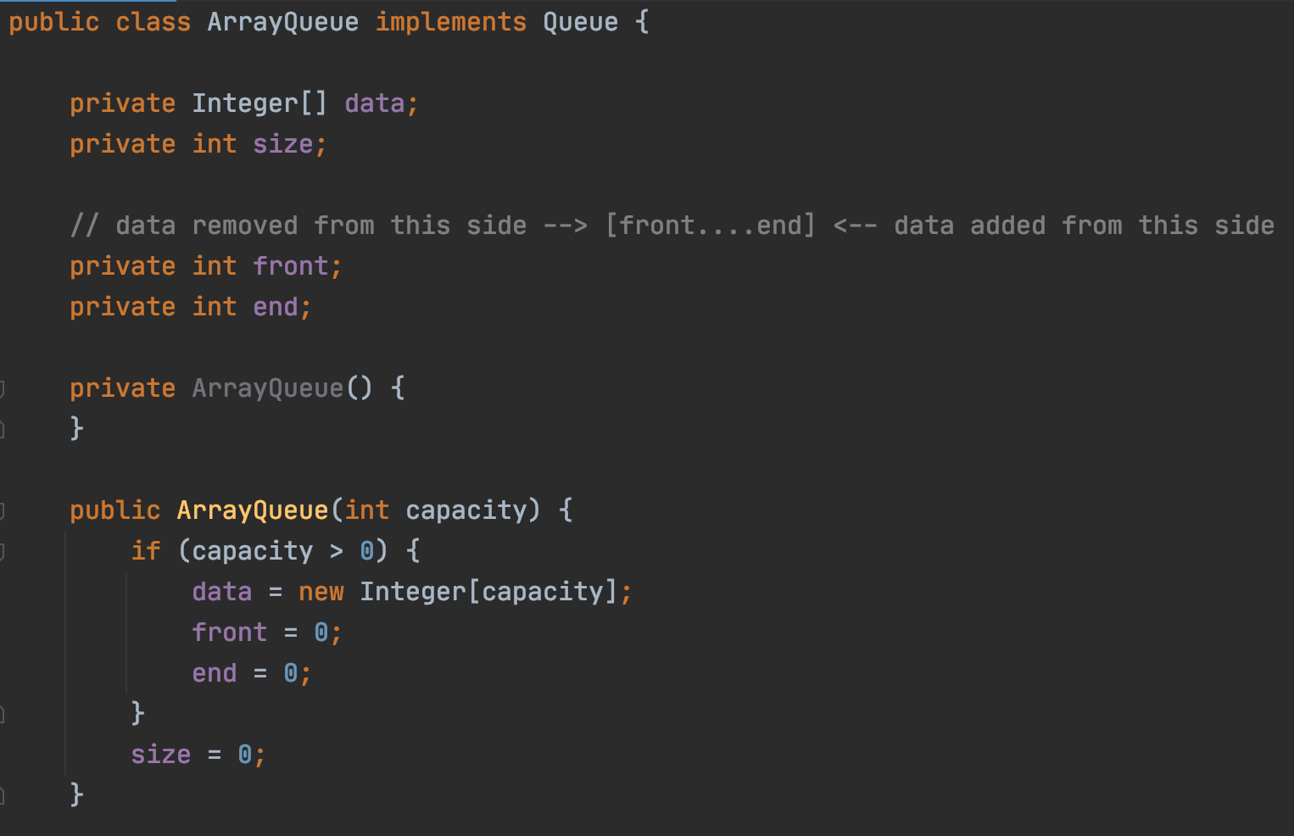
ADT Queue

Slide 9
Fixed Queue Capacity
Not flexible
Can be solved by making ”silent” copy, but slow
Possible to have “unlimited capacity” without doing copies?

Slide 10
ADT Queue
Remove the limitation of capacity
Option 1: Better/smarter Algorithm
Option 1: Better/smarter Algorithm
Faster driver
Option 2: Different data structure
Faster car

Slide 11
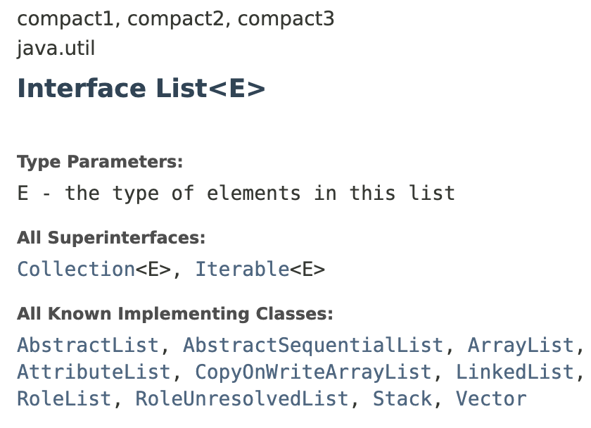

Introducing…

Slide 12


Array vs List
12
12
1
7
18
10
3
Array index
0
1
2
3
4
5
6
Memory address (Hexadecimal)
0x00
0x04
0x08
0x0C
0x10
0x14
0x18

Slide 13
Array → List
12
12
1
7
18
10
3
head
12
12
12
1
7
18
10
3
null
value
“Node”
reference

Slide 14
Memory Layout
list
array
Memory space

Slide 15
Memory Layout
addr0
12
addr1
addr8
addr2
addr3
addr4
7
addr0
addr5
addr10
addr1
12
addr6
head
addr2
12
addr0
addr7
addr3
12
1
addr8
addr4
1
addr4
addr9
addr5
7
18
addr10
addr6
18
addr11
addr14
addr7
10
addr12
3
addr8
3
addr13
null
addr9
addr14
10
addr10
addr15
addr12
array
list
addr16

Slide 16
Array vs List
Array:
Contiguous in memory
Fast random access
Fixed size
12
12
1
7
18
10
3
head
12
12
1
7
18
10
3
null
LinkedList:
Random addressed in memory
No random access
Size not fixed
← To use in our queue
More comparison between array and linked list

Slide 17
Single Linked List vs Double Linked List
head
12
12
1
7
18
10
3
Single/Singly Linked List
null
head
12
12
1
7
18
10
3
null
null
Double/Doubly Linked List

Slide 18
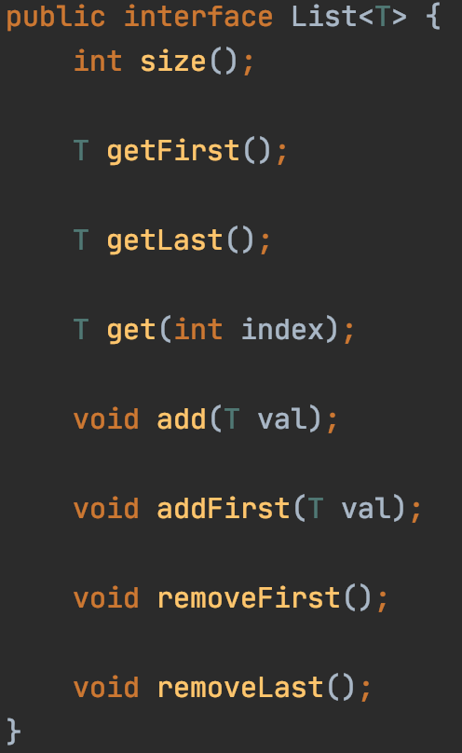
Linked List
head
12
12
1
7
18
10
3
null
“interface”

Slide 19
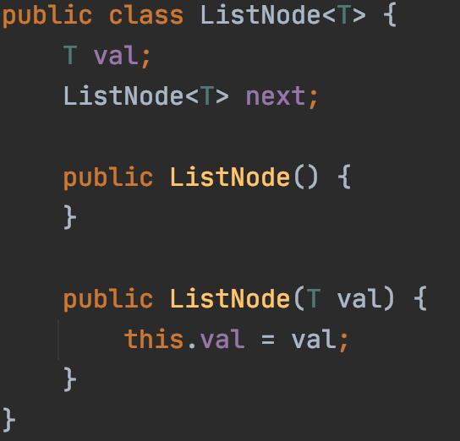
Linked List
“Implementation”
Next
Next
Next
Next
end
“Node”
value
reference

Slide 20
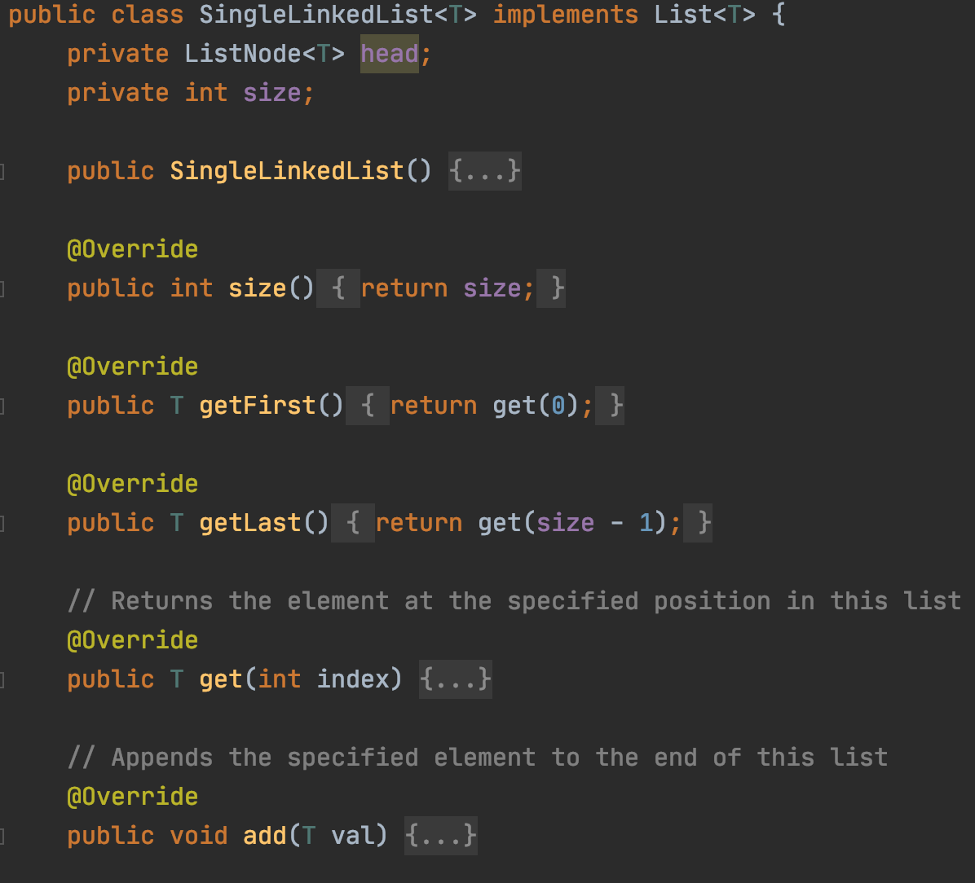
Single Linked List
end
Next
Next
Next
Next
“Implementation”

Slide 21
Interface vs Implementation

Slide 22
Single Linked List
Now let’s implement the functions:
add(value) : Add a node in the end addFirst(value) : Add a node in the beginning
removeFirst() : Remove a node from the beginning removeLast() : Remove a node from the end
getFirst() : Return the first node getLast() : Return the last node
size() : Size of the list

Slide 23
SingleLinkedList::add(int val)
Add a node with value to the end of the list
head
12
12
1
10
3

Slide 24
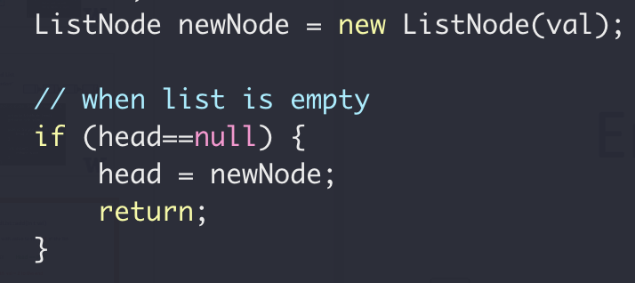
SingleLinkedList::add(int val)
Add a node with value to the end of the list
Empty List
head == null
Add a node with val = 2 to the end
val = 2
head
null
Next

Slide 25
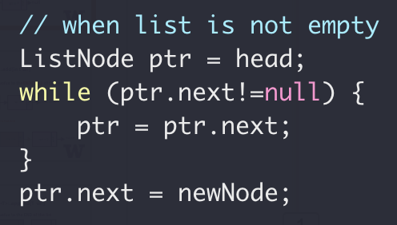
SingleLinkedList::add(int val)
Add a node with value to the end of the list
val = 2
head
null
Next
Add a node with val = 3 to the end
val = 2
val = 3
head
Next
null
Next
null

Slide 26
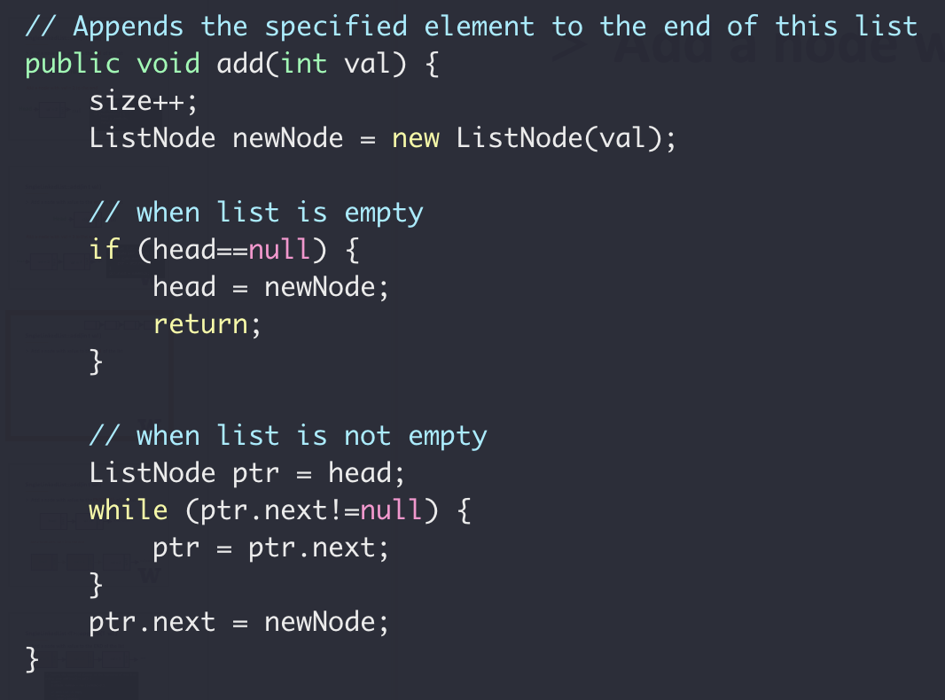
SingleLinkedList::add(int val)
Next
Next
Next
Next
end
Add a node with value to the end of the list

Slide 27
SingleLinkedList::addFirst(int val)
Add a node to the beginning of the list
val = 2
val = 3
head
null
null
Next
Next
val = 1
Next

Slide 28
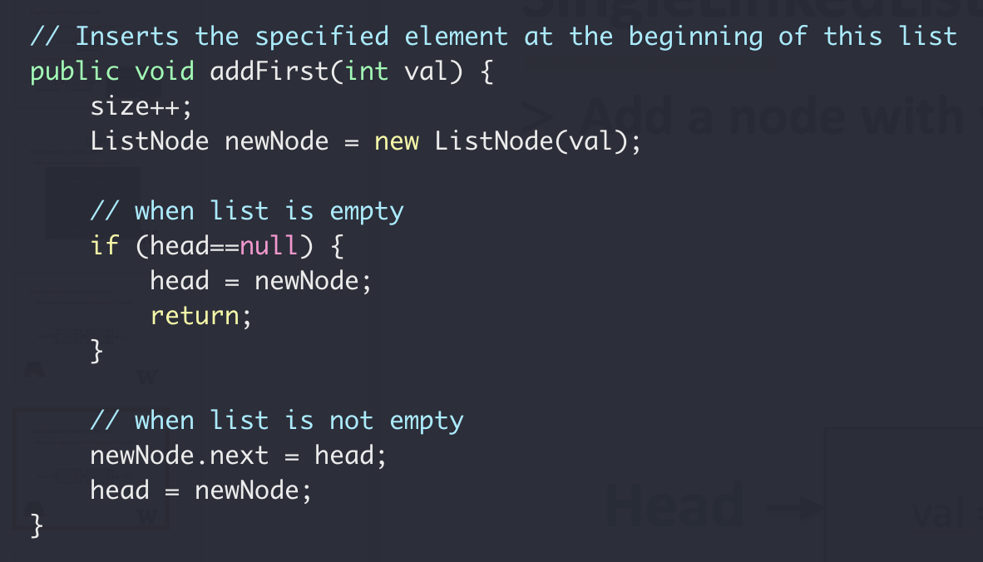
SingleLinkedList::addFirst(int val)
head
Next
Next
Next
Next
end
Add a node to the beginning of the list

Slide 29
SingleLinkedList::removeFirst(int val)
Remove the first node of the list
val = 2
val = 3
head
null
null
Next
Next

Slide 30
SingleLinkedList::removeFirst(int val)
Remove the first node of the list
Empty List
head == null
None-empty List
head
val = 2
val = 3
null
null
Next
Next

Slide 31
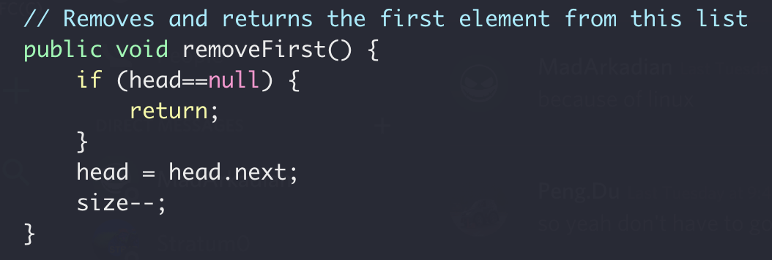
SingleLinkedList::removeFirst(int val)
Remove the first node of the list

Slide 32
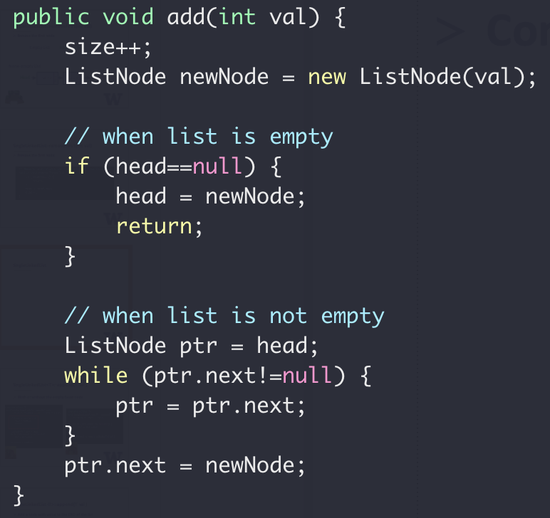
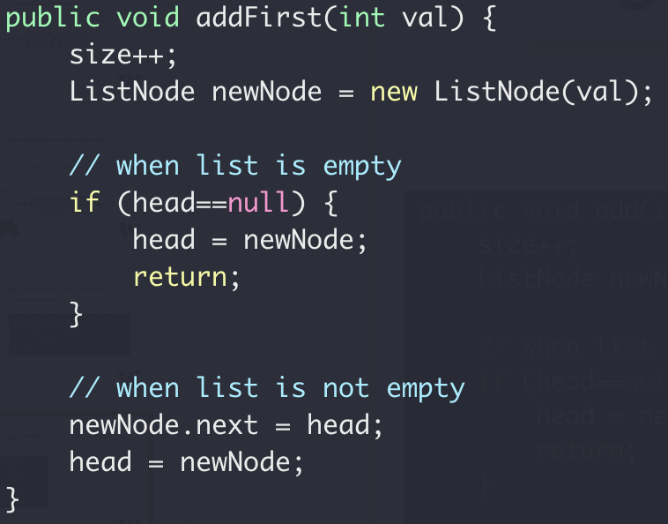
SingleLinkedList
head
end
Next
Next
Next
Next
Special case for empty list

Slide 33
SingleLinkedList
Sentry/dummy node
head
val = 2
val = 3
null
null
Next
Next
val = 2
val = 3
head
Next
null
null
Next
Next
Sentry/dummy node
Always exists since list creation
Value is not used

Slide 34
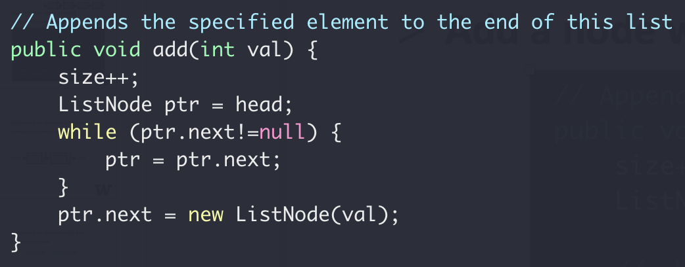
SingleLinkedList::add(int val)
Add a node with value to the end of the list
With sentry node

Slide 35
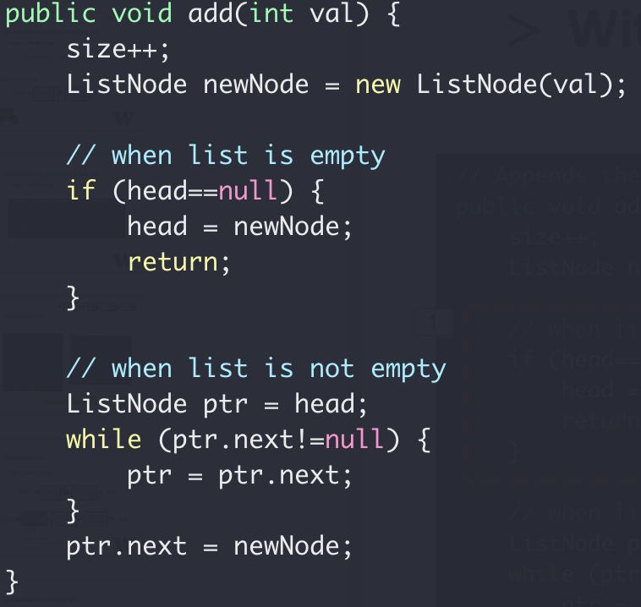
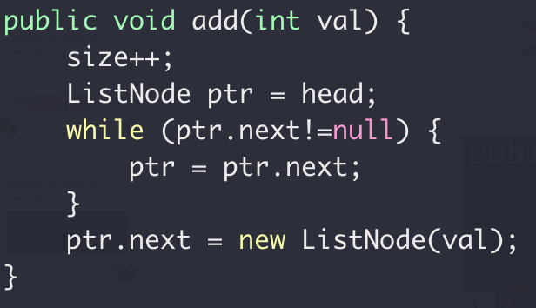


SingleLinkedList::add(int val)
Add a node with value to the end of the list

Slide 36
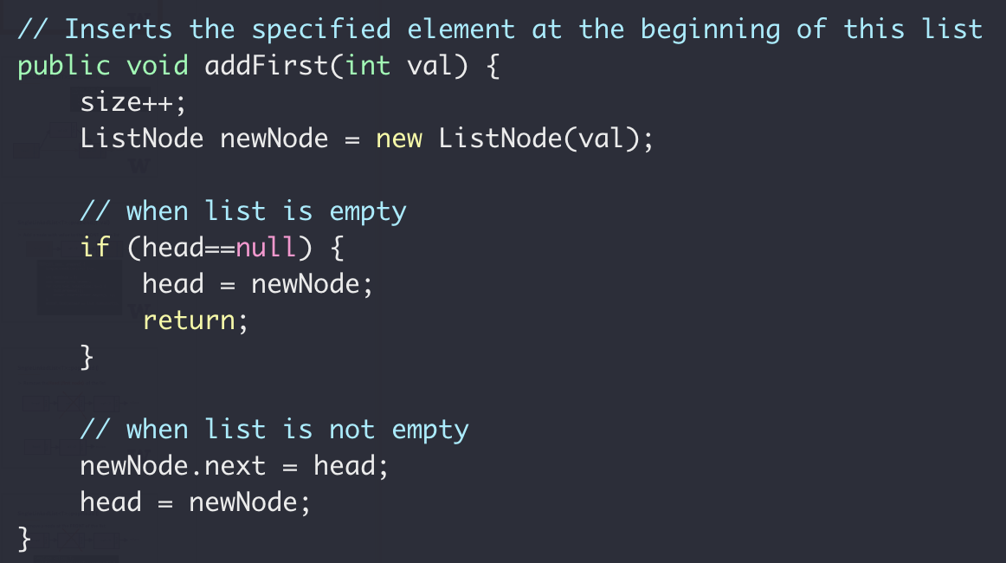
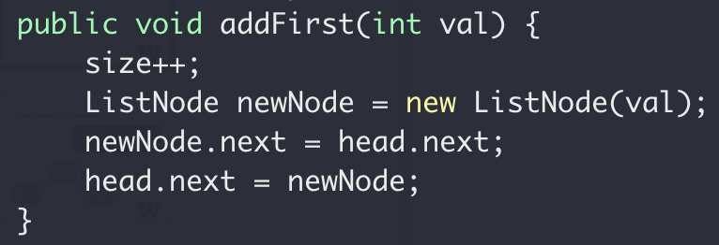
SingleLinkedList::addFirst(int val)
Add a node to the beginning of the list
without dummy node
with dummy node

Slide 37
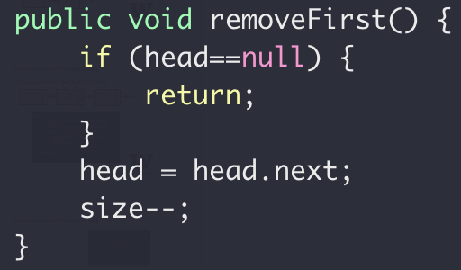
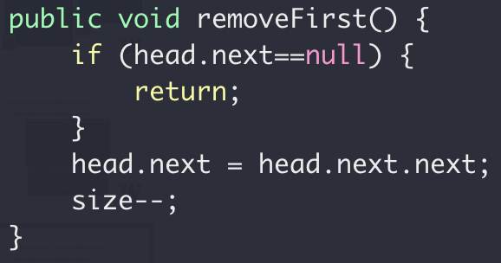
SingleLinkedList::removeFirst(int val)
Remove the first node of the list
without dummy node
with dummy node

Slide 38
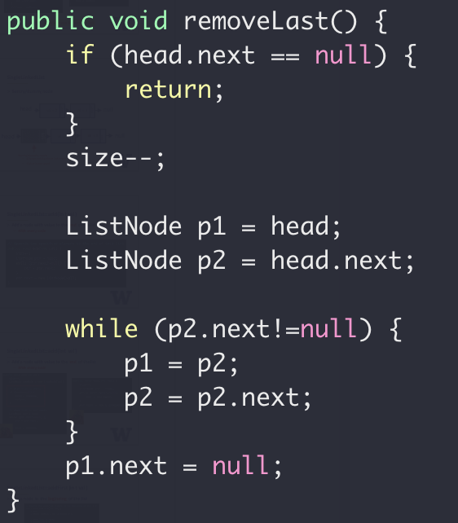
SingleLinkedList::removeLast()
Use dummy node
?
h → 2 → 5 → N
p1
p2

Slide 39
SingleLinkedList::removeLast()
Use sentry node
h → 2 → 5 → N
h → 2 → N
p1
p2

Slide 40
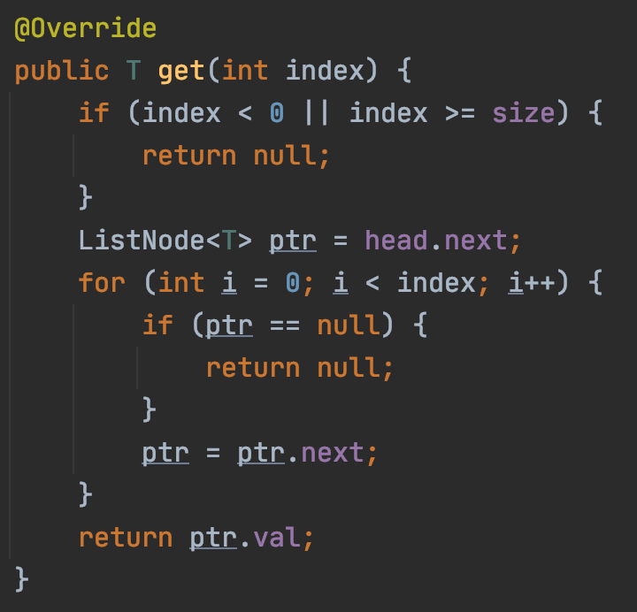
SingleLinkedList::get(int index)
Returns the element at the specified position in this list
With dummy node
get(0) returns {2, true}
get(1) returns {5, true}
get(3) returns {-1, false}
h → 2 → 5 → 1 → N
p1

Slide 41
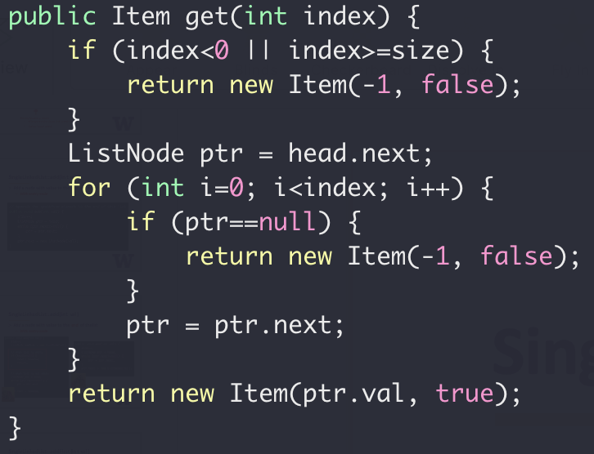
SingleLinkedList::get(int index)
Returns the element at the specified position in this list
h → 2 → 5 → 1 → N
How many steps to get list[2]?
For an array instead, how many steps to get array[2]?

Slide 42
Practice
Given the head pointer (assuming dummy head node)
Find whether the list has a loop

Slide 43

Practice
Head → 0 → 1 → 2 → 3 → 4 → 5
8
7
6

Slide 44
Practice
p0
p0
p0
p0
p1
head → 0 → 1 → 2 → 3 → 4 → 5
p1
p1
8
7
6
p1

Slide 45
ADT Queue

Slide 46
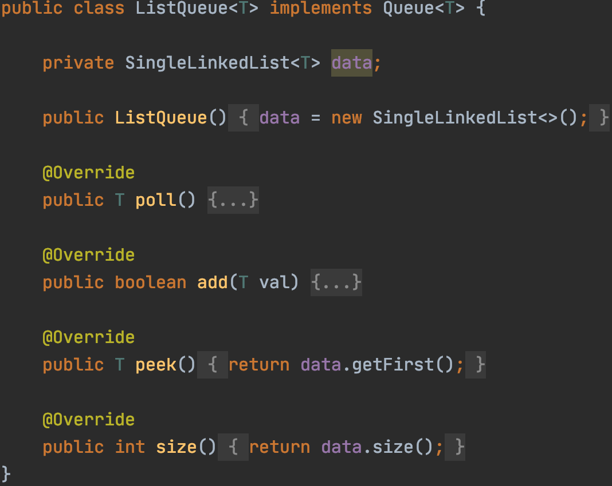
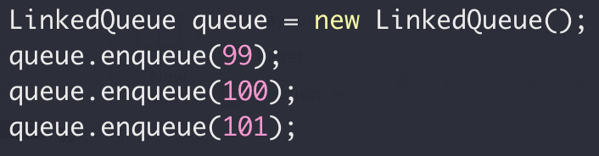

Queue with Linked List
No more space limitation

Slide 47

What’s the benefit of interface again?
Code here

Slide 48
ADT Queue
ADT Queue
Interface
add()
poll()
size()
Implementation
Public Access
Linked List
Array

Slide 49
ADT List
Okay, What’s the difference between this two classes?

Slide 50
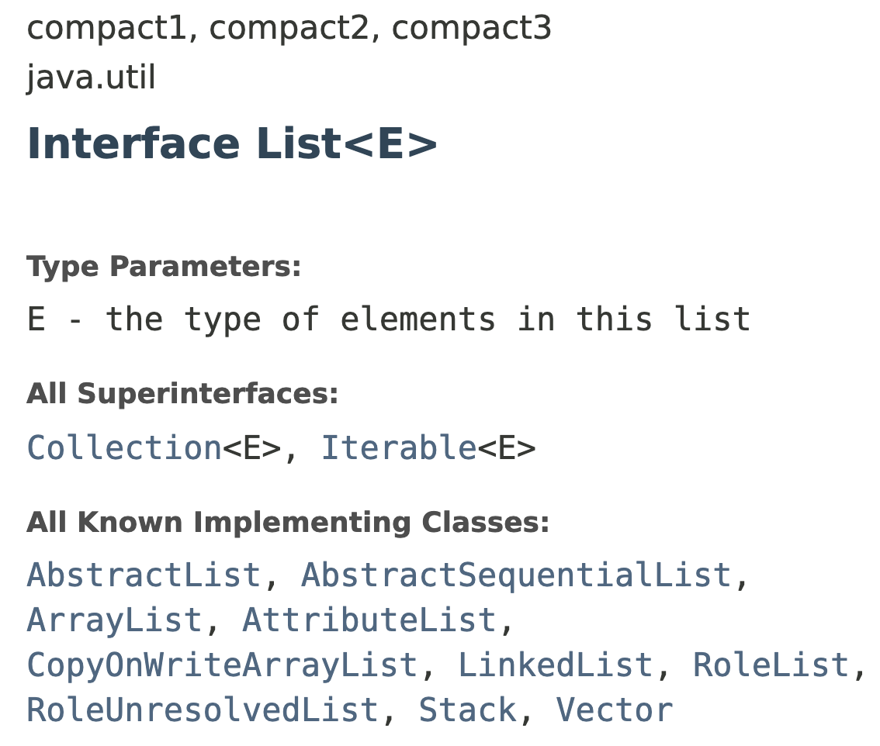
ADT List

Slide 51
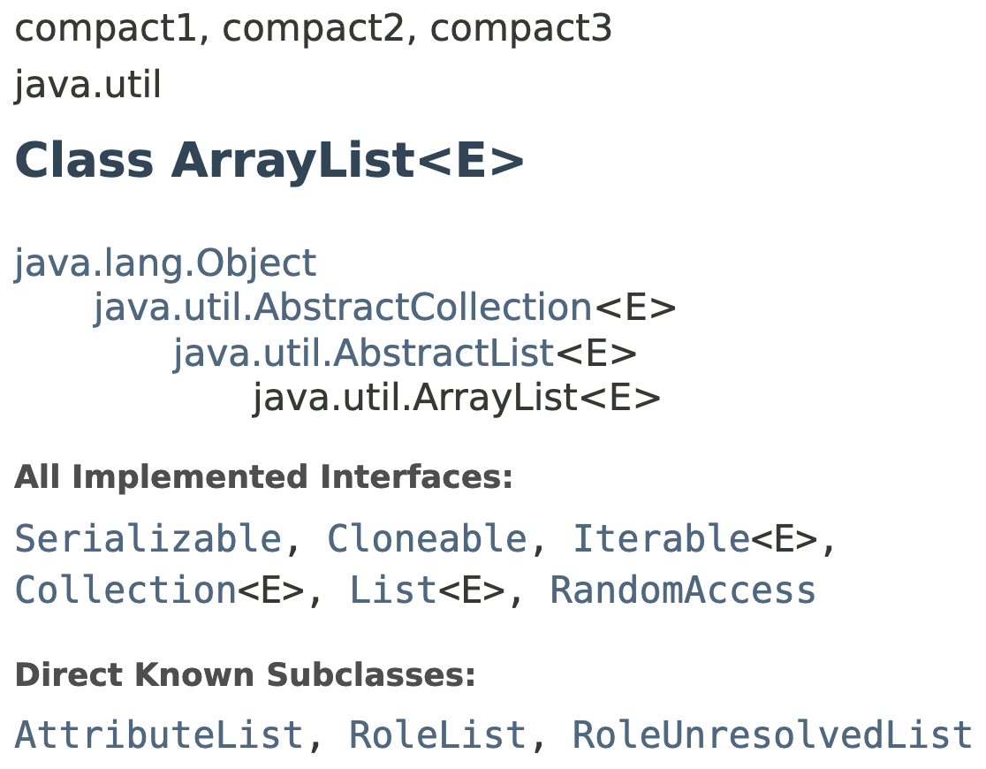
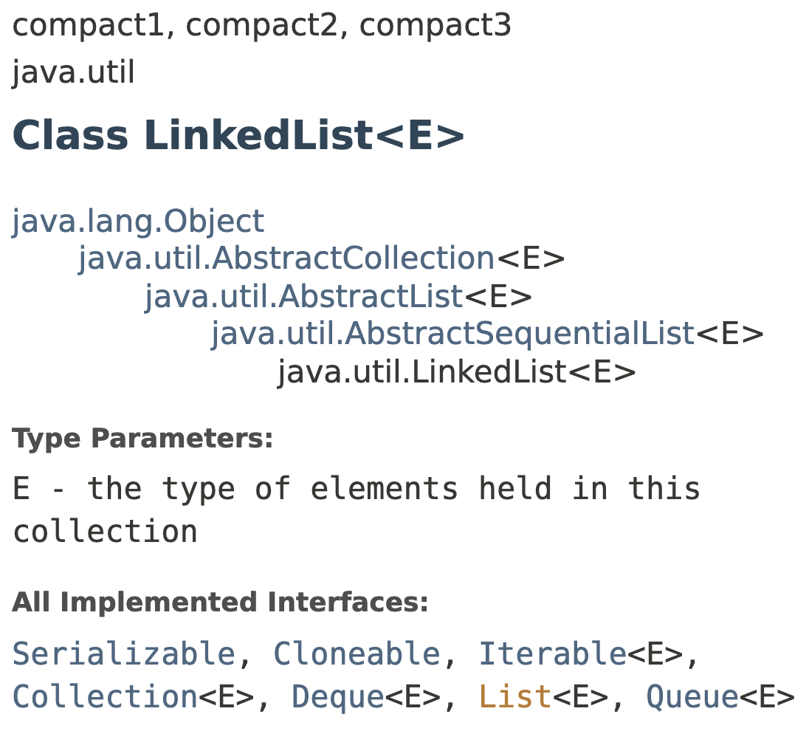
ADT List

Slide 52
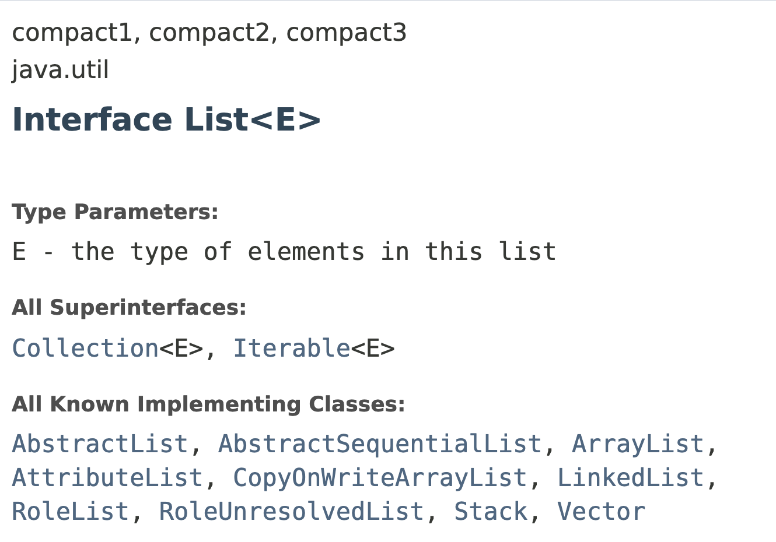
ADT List from java.util
So, What’s the difference between this two classes?
What about all these?

Slide 53
ADT Summary
Abstract Data Type
Interface
Implementation
Public Access

Slide 54

Next week
Monday
Homework 1 review
Homework 2 due on Monday midnight
Homework 3 due on Thursday
Lecture
More on List, Queue, Stack
More Code-along
Wednesday
Midterm 1
Java basics, OOP
ADT (Queue, Stack, List)
image source

